Slide 1
SDS Shower Test
04-03-2019

Slide 2
Shower Test
This test is to determine if any of the SDS Shell openings (Vents, doors, Back panel) can let in water when exposed to rain

Slide 3
Risks
Leakages lead to:
Electrical components getting damaged
Rust in metallic parts
Electrocution
Equipment failure

Slide 4
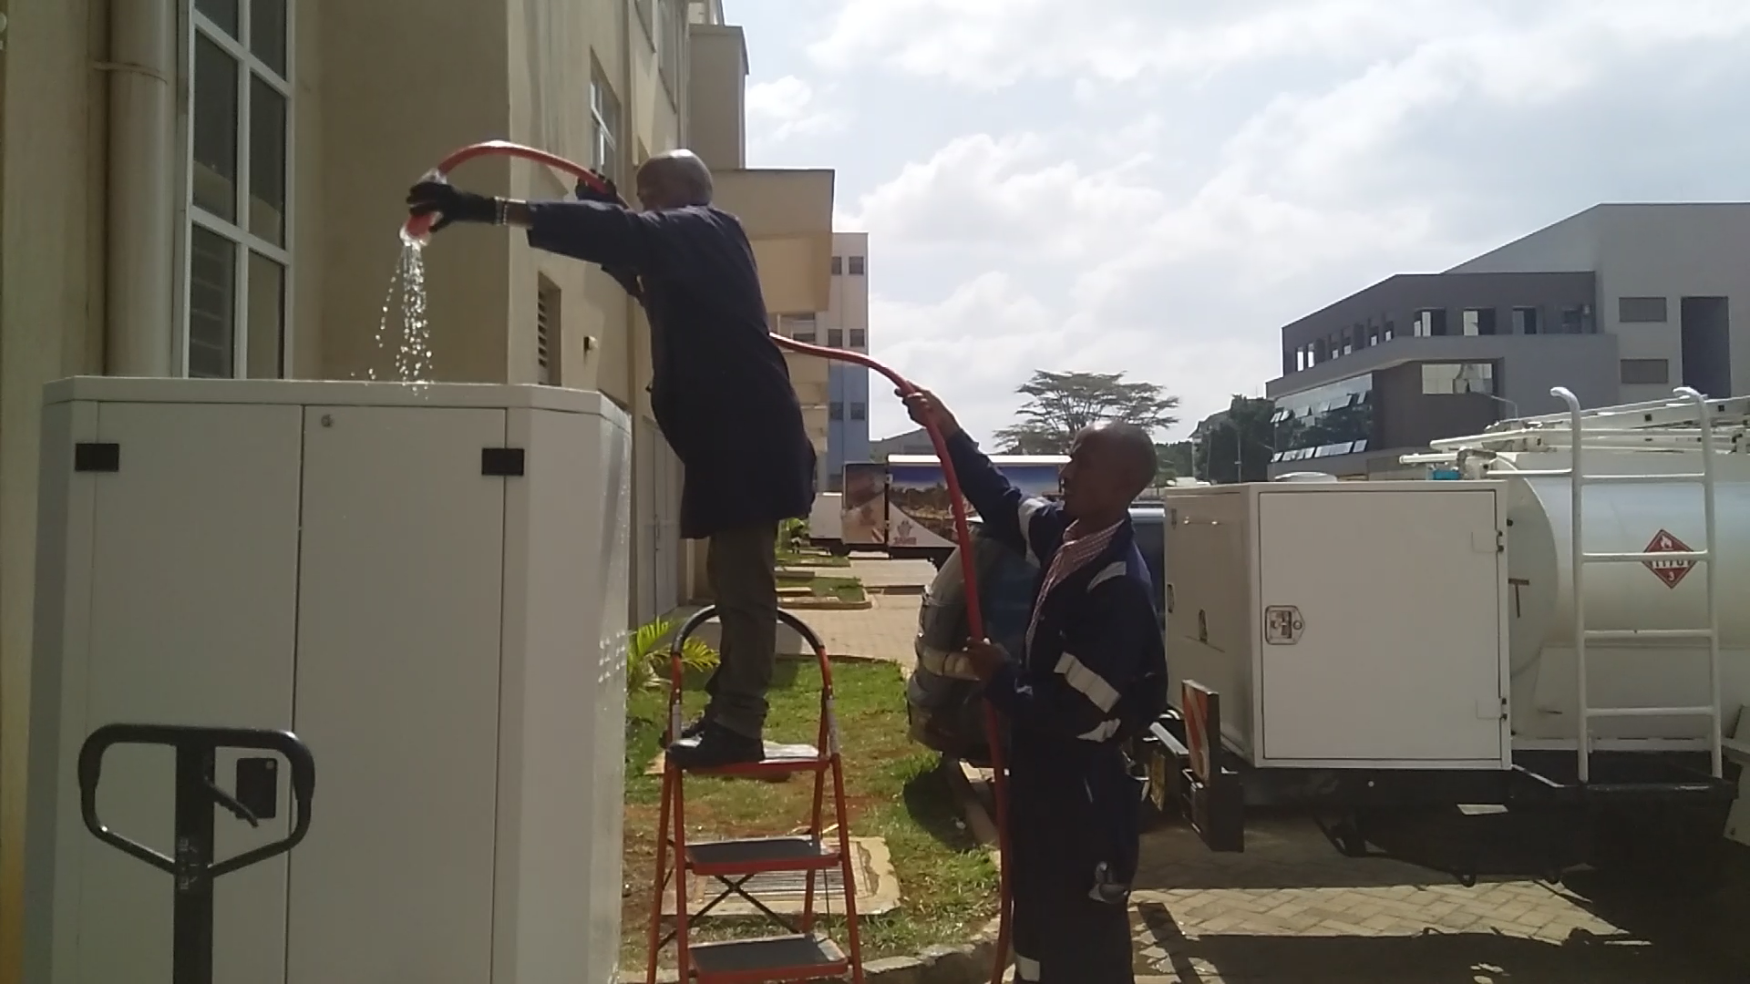
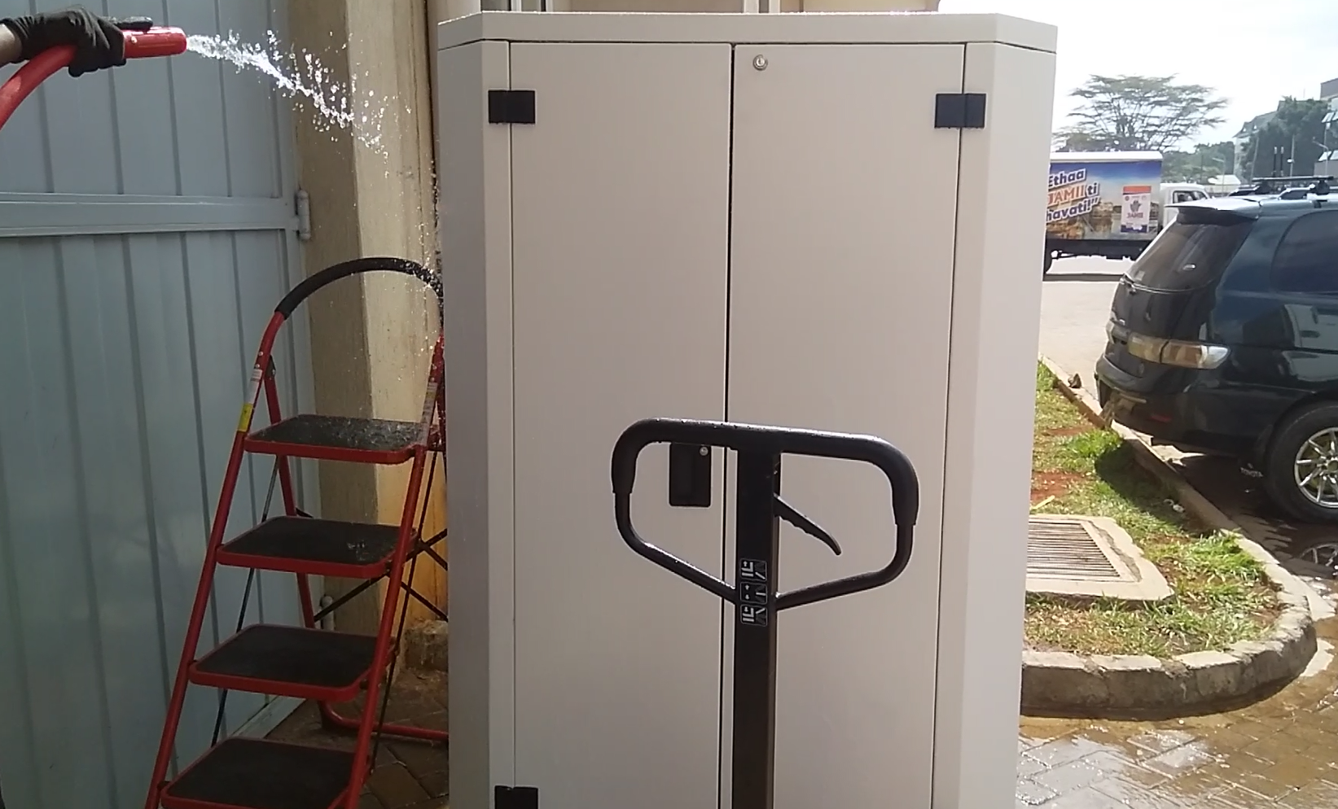
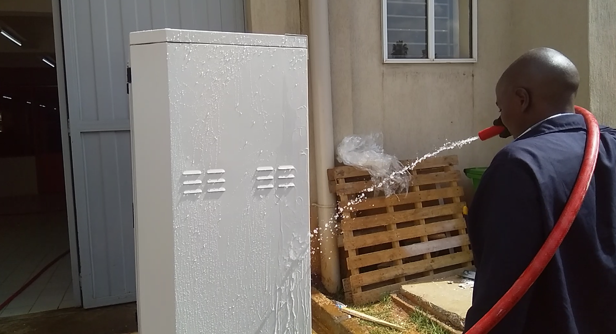
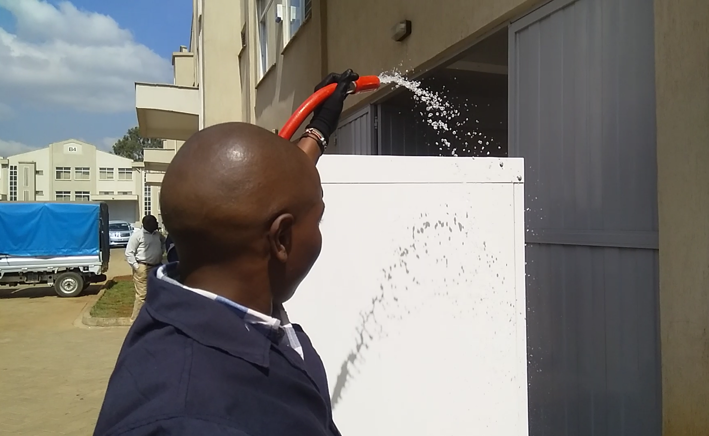
Pictures and Videos
1
Video Link

Slide 5
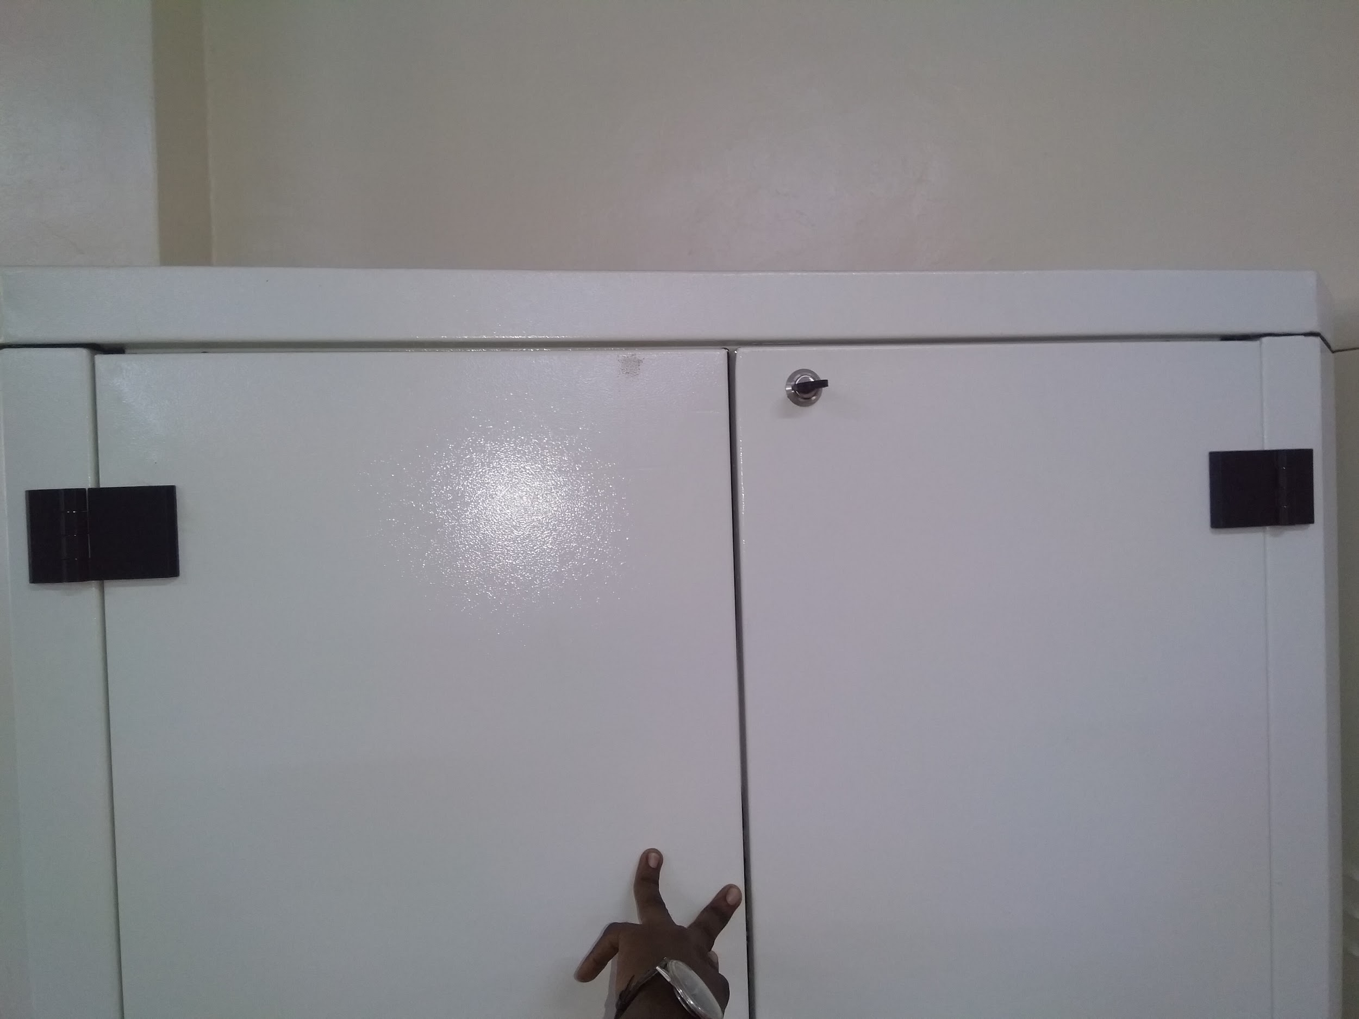
Observations
Leakage Area
Leakages were observed
originating from door openings(Top) -

